Slide 1
Best Location for Free Wireless Access Point in Reston, VA
PART (ll)
NVCC GIS 201
By: Chris Weidemann
ChrisWeidemann@gmail.com
© 2007-2008 Chris Weidemann

Slide 2
Why Free Internet?
Save residents money
Advertising dollars
Offer access to internet at locations you wouldn't normally receive it.
Offer access to those that couldn’t normally afford internet.
© 2007-2008 Chris Weidemann

Slide 3
Who else is doing it?
Municipalities: San Francisco, Philadelphia, Dade County
Private Companies: MetroFi, Earthlink, Google
© 2007-2008 Chris Weidemann

Slide 4
Quick Recap of Part (l):
Where are the access points?
Where are the residential access points (potential customers) in northern Reston, Virginia?
Data Collection
Data prepping
Importation into GIS
Observation of Trends
© 2007-2008 Chris Weidemann

Slide 5
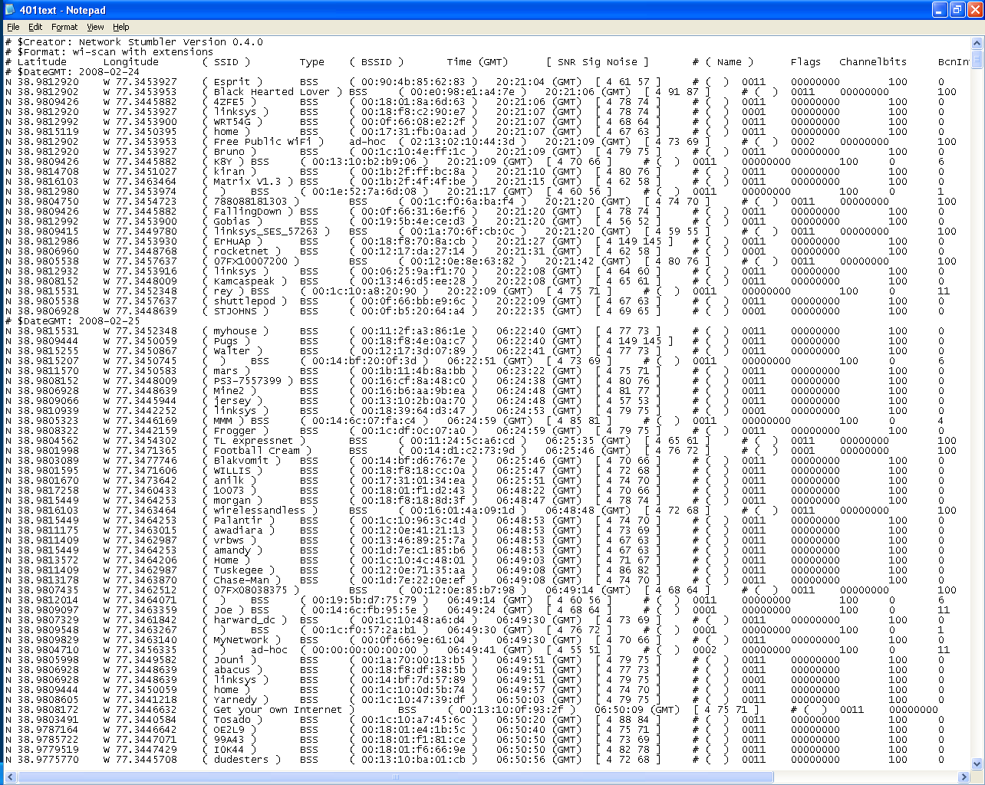
© 2007-2008 Chris Weidemann

Slide 6
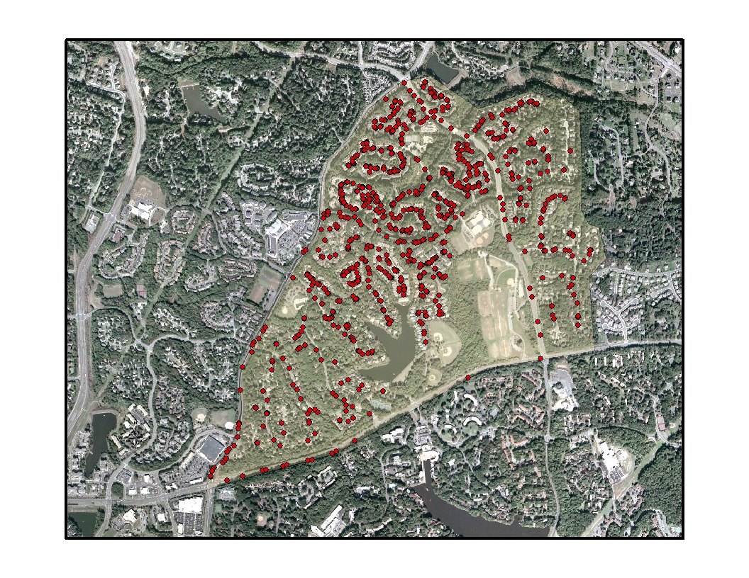
© 2007-2008 Chris Weidemann

Slide 7
Part (ll)
Best location for a free wireless access point?
© 2007-2008 Chris Weidemann

Slide 8
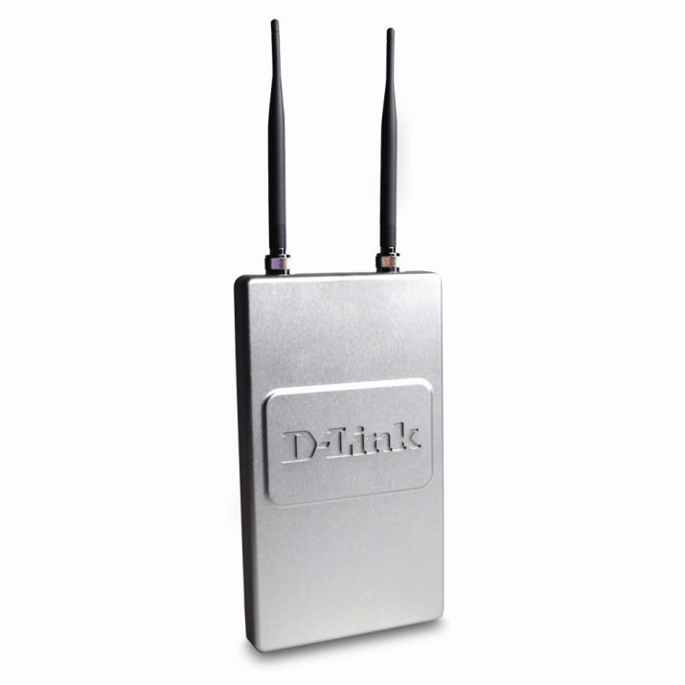
Access Point – DWL-2700AP
801.11G
Max range of 500m
Max speed of 54Mbps @112m
250m @ 18 Mbps
Proposed Range 250m
© 2007-2008 Chris Weidemann

Slide 9
Other Data:
VA – Northern Areas 1.0ft (Feb 2002)
USGS National Elevation Dataset
© 2007-2008 Chris Weidemann

Slide 10
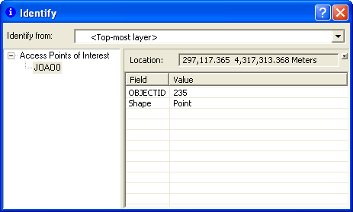
Prep work - GeoMasking
Confidentiality of potential customer
© 2007-2008 Chris Weidemann

Slide 11
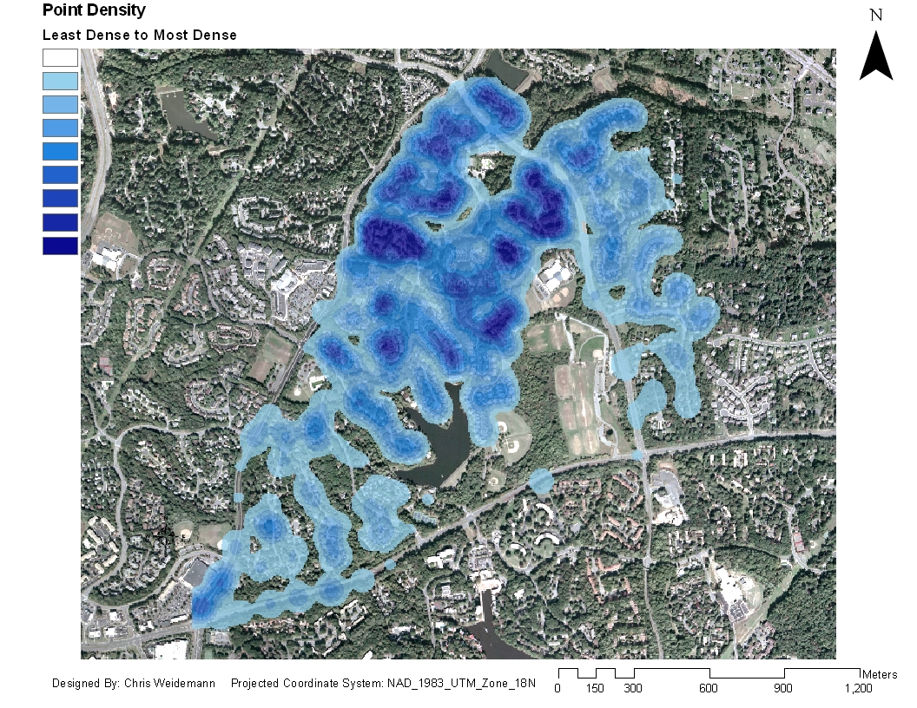
© 2007-2008 Chris Weidemann

Slide 12
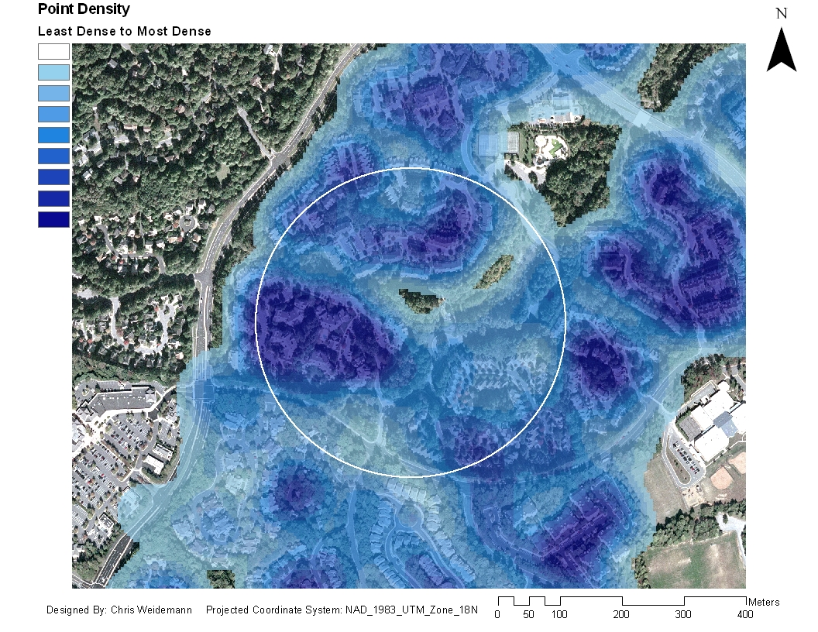
256 POI in 250 m Radius
© 2007-2008 Chris Weidemann

Slide 13
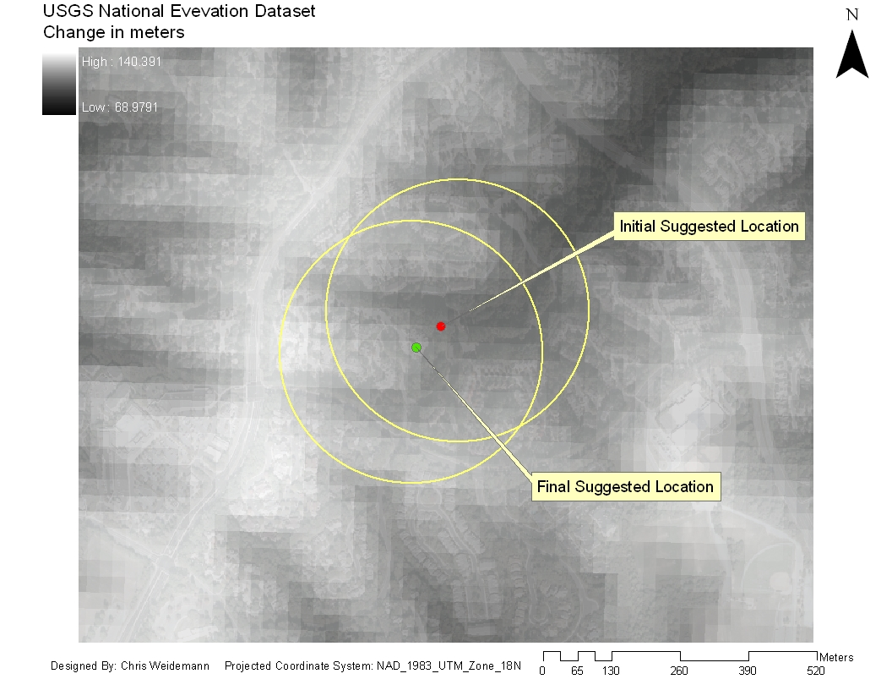
232 POI in 250 m Radius
© 2007-2008 Chris Weidemann

Slide 14
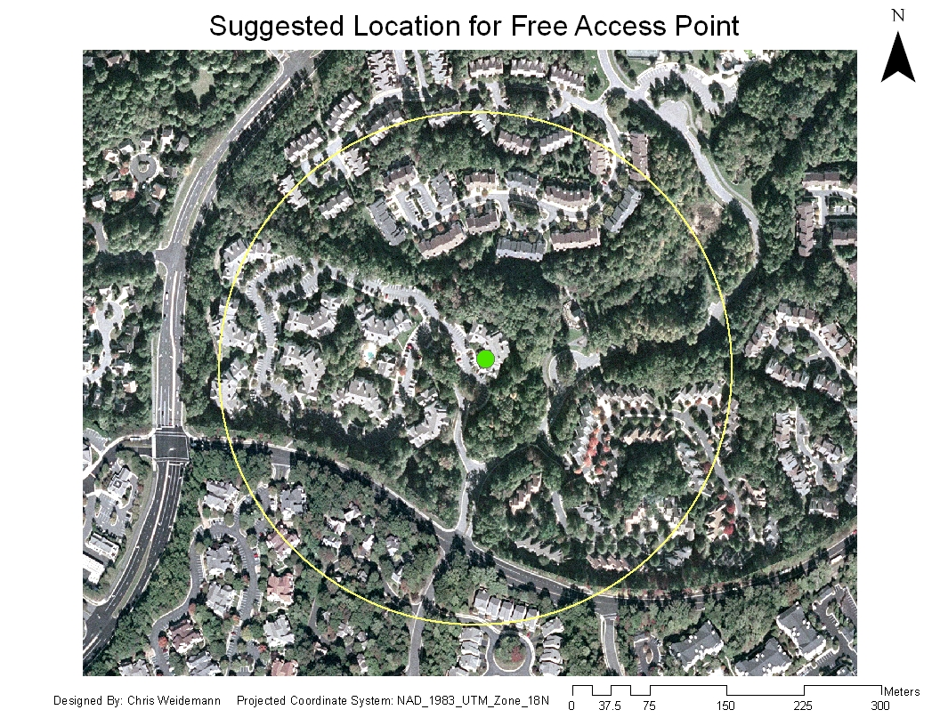
© 2007-2008 Chris Weidemann

Slide 15
Additional Analysis
Based on 10 random samplings –
Average of 120 customers in any given area.
Based on an average pricing of local ISPs –
$53.35 – Per customer, per month
$6402.00 – Potential savings generated per free AP
Based on 2 hours of daily use – each customer is worth $4-$7 a month
$480-$840 – Potential average earnings per month
Linksys #1 used router – 38%
**Assumption that 1 point = 1 customer
© 2007-2008 Chris Weidemann

Slide 16
Other variables to consider
Income level – Can they not afford an wireless access point?
Who would be inclined to not use it?
How do parks and commercial zones get rated, valued?
One point = one customer?
Large residential homes hold a higher value then apartments?
© 2007-2008 Chris Weidemann

Slide 17
Suggestions for further research
Consider alternate mode of collection (bike or walking)
Triangulate access point location
LIDAR for elevation
Real world testing of Access Point’s range.
Better understand of the relationship between low income and wireless access.
© 2007-2008 Chris Weidemann

Slide 18
Conclusion
Suggested Location:
East building at St. John’s Wood Apartment
Suggested Sites est. earnings:
$928-$1,624 per month
Potential savings to the customer:
$12,365.60 per month
© 2007-2008 Chris Weidemann

